Slide 1
Ch. 10 Timeline
By: Carson Stark

Slide 2
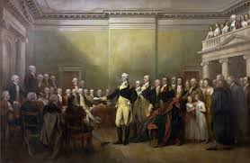
George Washington Elected

Slide 3
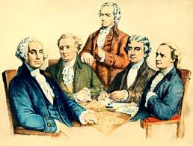
Cabinet is selected

Slide 4
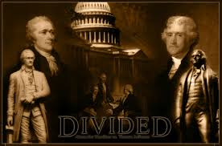
The Rise of Political Parties

Slide 5
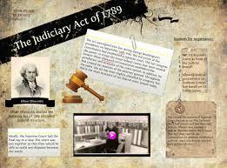
Judiciary Act of 1789

Slide 6
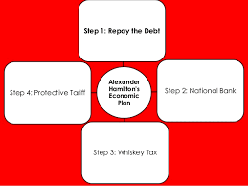
Hamilton’s Economic Plan

Slide 7
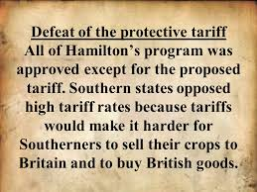
Defeat of the Protective Tariff

Slide 8
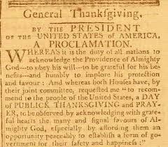
Proclamation of Nuetrality

Slide 9
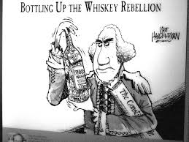
The Whiskey Rebellion of 1794

Slide 10
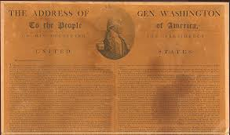
Washington’s Farewell Address

